Slide 1
PBCST304 Object Oriented Programming in Java
Module 4
(Part 2)
Prepared by
Renetha J.B.

Slide 2
Topics
Swings
  MVC
  Swing Controls
  Components and Containers

Slide 3
MVC
(Model View Controller)
A visual component is a composite of three distinct aspects:
  The state information associated with the component MODEL
  The way that the component looks when rendered on the screen VIEW
  The way that the component reacts to the user- CONTROLLER
MVC (Model View Controller) architecture is successful because each piece of the design corresponds to an aspect of a component.

Slide 4
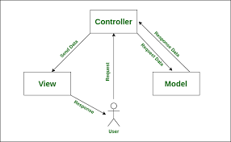

Slide 5
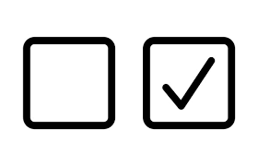
MVC(contd.)
In MVC terminology,
  the Model corresponds to the state information associated with the component.
    For example, in the case of a check box, the model contains a field that indicates if the box is checked or unchecked.
  The View determines how the component is displayed on the screen
  The Controller determines how the component reacts to the user.
    For example, when the user clicks a check box, the controller reacts by changing the model to reflect the user’s choice (checked or unchecked). So, the view changes.

Slide 6
E.g. MVC - Shopping list app
The Model
The model defines what data the app should contain. If the state of this data changes, then the model will usually notify the view (so the display can change as needed) and sometimes the controller (if different logic is needed to control the updated view).
E.g Shopping list app, the model would specify what data the list items should contain — item, price, etc. — and what list items are already present.
The View
In shopping list app, the view would define how the list is presented to the user, and receive the data to display from the model.

Slide 7
The Controller
The controller contains logic that updates the model and/or view in response to input from the users of the app.
Shopping list app could have input forms and buttons that allow us to add or delete items.
  These actions require the model to be updated, so the input is sent to the controller, which then manipulates the model as appropriate, which then sends updated data to the view.

Slide 8
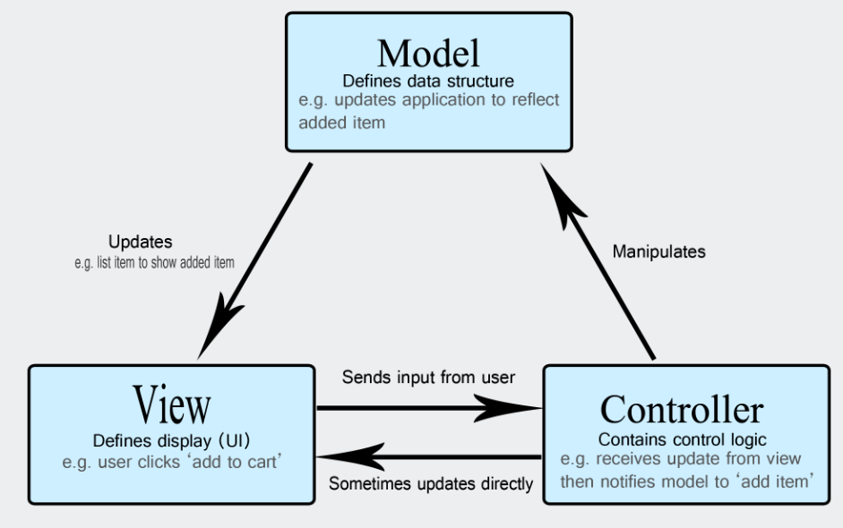

Slide 9
MVC(contd.)
By separating a component into a model, a view, and a controller, the specific implementation of each can be changed without affecting the other two.
Swing uses a modified version of MVC that combines the view and the controller into a single logical entity called the UI delegate.
  So, Swing’s approach is called either the Model-Delegate architecture or the Separable Model architecture.

Slide 10
MVC(contd.)
Swing’s pluggable look and feel is made possible by its Model-Delegate architecture.
Because the view (look) and controller (feel) are separate from the model, the look and feel can be changed without affecting how the component is used within a program.

Slide 11
MVC(contd.)
To support the Model-Delegate architecture, most Swing components contain two objects.
  The first represents the model.
    Models are defined by interfaces
  The second represents the UI delegate.
    UI delegates are classes that inherit ComponentUI.

Slide 12
Swing Controls
Swing controls plays major role in swing applications, every application will have some components and their corresponding event listener.
Swing controls will inherit the properties from following classes.
  Component
  Container
  JComponent.

Slide 13
Components and Containers
A Swing GUI consists of two key items: components and containers
A container holds a group of components.
  So a container is a special type of component that is designed to hold other components.
  i.e. To display a component, it must be held within a container.
So, all Swing GUIs will have at least one container.
Since containers are components, a container can also hold other containers.

Slide 14
Components
Swing components are derived from the JComponent class.
JComponent provides the functionality that is common to all components.
  E.g JComponent supports the pluggable look and feel.
JComponent inherits the AWT classes Container and Component..
  So, a Swing component is built on and compatible with an AWT component.

Slide 15
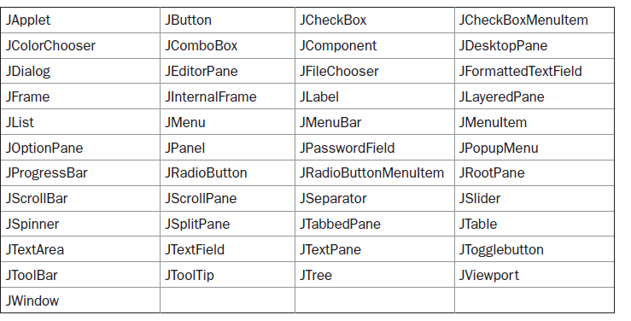
Components(contd.)
All of Swing’s components are represented by classes defined in the package javax.swing.
The class names for Swing components are
* All component classes begin with the letter J for Java.

Slide 16
Containers
Swing defines two types of containers.
  The first are top-level containers
  The second type of containers supported by Swing are lightweight containers.

Slide 17
Containers(contd.)
The first are top-level containers
  JFrame, JApplet, JWindow, and JDialog.
  These containers do not inherit JComponent
  They inherit the AWT classes Component and Container
  The top-level containers are heavyweight.
  A top-level container must be at the top of a containment hierarchy
    i.e Every containment hierarchy must begin with a top-level container.
  A top-level container cannot be contained within any other container.
  Jframe is the most commonly used container

Slide 18
Containers (contd.)
  The second type of containers supported by Swing are lightweight containers.
  Lightweight containers do inherit JComponent.
    E.g. JPanel is a general-purpose container.
  A lightweight container can be contained within another container.
  Lightweight containers are often used to organize and manage groups of related components
  We can use lightweight containers such as JPanel to create subgroups of related controls that are contained within an outer container.

Slide 19
Top-level containers
Lightweight containers.
Top level containers do not inherit Jcomponent.
Heavyweight
A top-level container is not contained within any other container.
E.g. JFrame, JApplet, JWindow, and JDialog
Lightweight containers do inherit JComponent.
Lightweight
A lightweight container can be contained within another container.
E.g. JPanel

Slide 20
The Top-Level Container Panes
The Top-Level Container Panes
  Each top-level container defines a set of panes.
  At the top of the hierarchy is an instance of JRootPane.
    JRootPane is a lightweight container to manage other panes and optional menu bar.
    JRootPane is made up of
      the glass pane,
      the content pane,
      the layered pane.

Slide 21
The Top-Level Container Panes
Glass pane :
  The glass pane is the top-level pane.
  It sits above and completely covers all other panes.
  By default, it is a transparent instance of JPanel.
Layered pane :
  The layered pane is an instance of JLayeredPane.
  The layered pane allows components to be given a depth value.
  This value determines which component overlays another.
Content pane:
  The pane with which your application will interact the most is the content pane
  When we add a component, such as a button, to a top- level container, we will add it to the content pane.
  By default, the content pane is an opaque instance of JPanel.

Slide 22
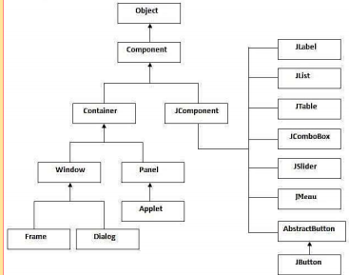

Slide 23
Reference
Herbert Schildt, Java: The Complete Reference, 8/e, Tata McGraw Hill, 2011.

